Slide 1

C# 6 New Features
Jon Limjap
Microsoft MVP for C#

Slide 2
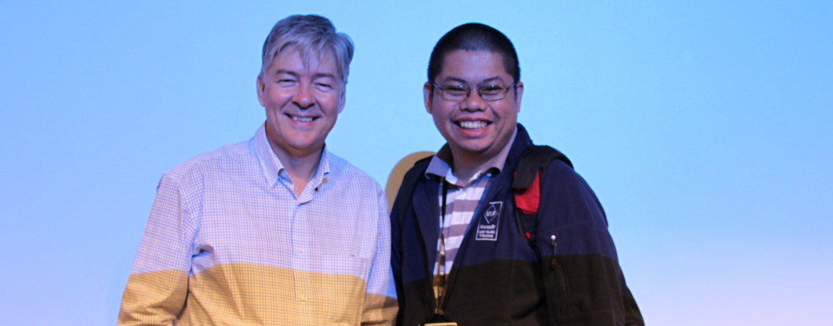

About Me
Microsoft MVP for C#
Technical Specialist, Provoke Solutions
President, Philippine .NET Users Group
http://dotnet.kapenilattex.com
@lattex | jonlimjap@gmail.com

Slide 3

Philippine .NET Users Group (PHINUG)
facebook.com/groups/phinug
@phinug
phinug.doorkeeper.jp

Slide 4
Agenda
A history of the continuous evolution of the C# language
C# 6.0 New features

Slide 5
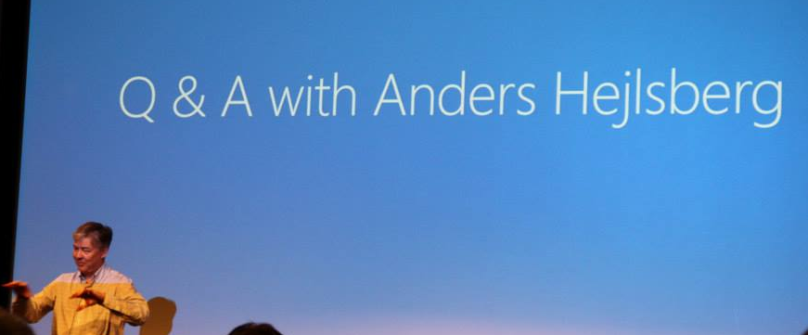
History
Continuous evolution of the C# language

Slide 6
C# 2.0 November 2005
Generics
Partial Classes
Anonymous Methods
Iterators
Nullable Types
Static Classes
More…

Slide 7
C# 3.0 Novermber 2007
Implicitly typed variables aka var keyword
Object and collection initializers
Auto-properties
Anonymous Types
Extension Methods
Language Integrated Query (LINQ)
Lambda Expressions
More…

Slide 8
C# 4.0 April 2010
Dynamic Binding
Named and Optional Parameters
Generic Covariance and Contravariance
More…

Slide 9
C# 5.0 August 2012
Asynchronous methods (async and await keywords)
Caller info attributes

Slide 10
C# 6.0
Not released yet ;)

Slide 11
New Features
Using statements for static members
Auto-property Initializers
Getter-only automatic properties
Dictionary Initializers
Expression-bodied members
Await inside a finally block
Exception Filters
Null Propagation
And a few more…

Slide 12
Using statement for Static Members
using System;
using System.Console;
namespace Csharp6Demo
{
class Program
{
static void Main(string[] args)
{
WriteLine(“WriteLine stands on its own :)");
}
}
}

Slide 13
Auto-property initializers
string FirstName { get; set; } = "Juan";
string LastName { get; set; } = "Dela Cruz";
DateTime BirthDate { get; set; } = new DateTime(1898, 6, 12);

Slide 14
Getter only Auto-properties
string OtherInfo { get; } = "Other information";

Slide 15
Dictionary Initializers
var madlangPeople = new Dictionary<string, Person>
{
["Jon"] = new Person("Jon", "Limjap", new DateTime(1990, 11, 23)),
["Toto"] = new Person("Toto", "Gamboa", new DateTime(1996, 7, 11)),
["Teril"] = new Person("Teril", "Bilog", new DateTime(1998, 7, 10))
};

Slide 16
Expression-bodied members
public int Age => Convert.ToInt32(DateTime.Now.Subtract(BirthDate).Days/365.25);

Slide 17
Await inside Catch and Finally blocks
public async Task SomeAsyncMethod()
{
try
{
await OperationThatMayThrowAsync();
}
catch (Exception ex)
{
await LogAsync(ex);
}
finally
{
await Cleanup();
}
}

Slide 18
Exception Filters
try
{
throw new Exception(message);
}
catch (Exception ex) if (ex.Message == "Filter me!")
{
WriteLine("Filtered!");
}
catch
{
WriteLine("Not filtered");
}

Slide 19
Null Propagation
public class Address
{
public string AddressLine1 { get; set; }
public string AddressLine2 { get; set; }
}
public class Person
{
//other code
public Address Address { get; set; }
}
var jon1 = new Person();
var jon2 = new Person() { Address = new Address { AddressLine1 = "6750 Ayala Ave" } };
WriteLine(jon1?.Address?.AddressLine1 ?? "No address");
WriteLine(jon2?.Address?.AddressLine1 ?? "No address too");
WriteLine(jon2?.Address?.AddressLine2 ?? "No address either");

Slide 20
Thank you!
Q & A

Slide 21
References
https://roslyn.codeplex.com/wikipage?title=Language%20feature%20status&referringTitle=Home
http://www.youtube.com/watch?v=BA3sL783_Co

